Slide 1

Mini Project
Blockchain System for KEEPING a digital trail of ownership, and transacting Music rights between Artists, distributors, publishers, and record labels.
TM MONARE 221022037
15 May 2024
Computer Science 3a

Slide 2


Introduction
Problem statement: Artists are exploited by record labels due to a lack of control over music masters and IP rights, limiting their ability to benefit from their work.
Proposed Solution: A blockchain-based system for artists to upload and tokenize their music, enabling ownership control and secure rights transactions while establishing a digital trail for copyright enforcement.
User Types
1. Artist
2. Distributor
3. Publisher
4. Record Label

Slide 3
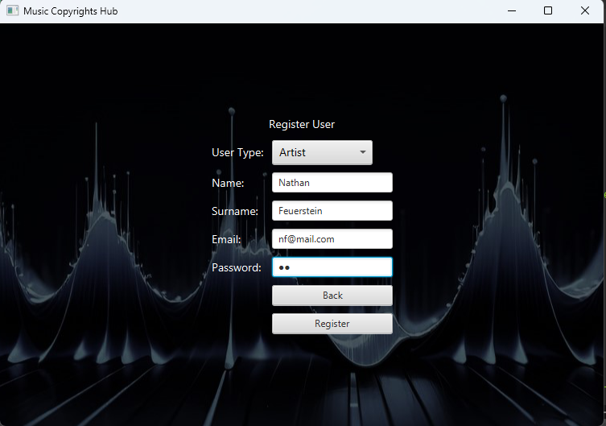
Artist Register

Slide 4
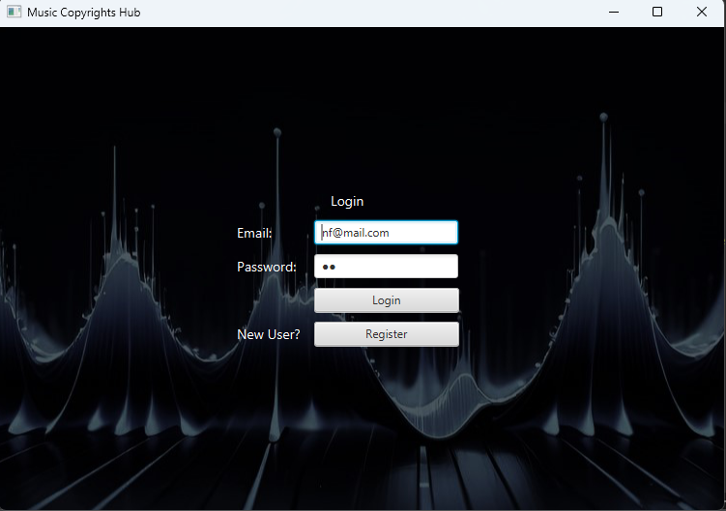
Artist Login

Slide 5
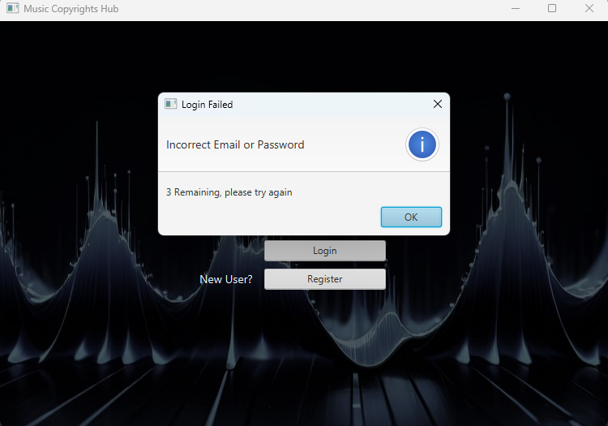
Artist Login

Slide 6
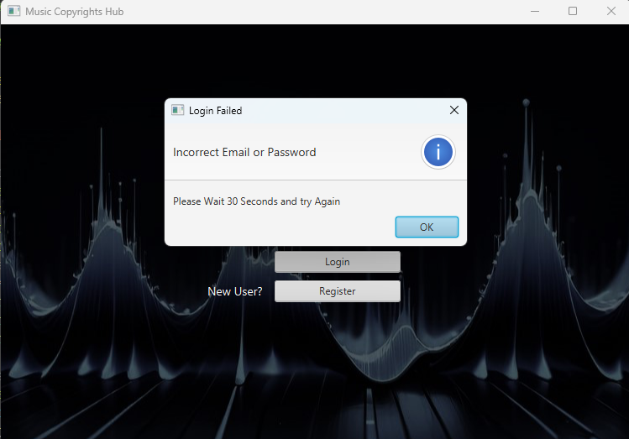
Artist Login

Slide 7
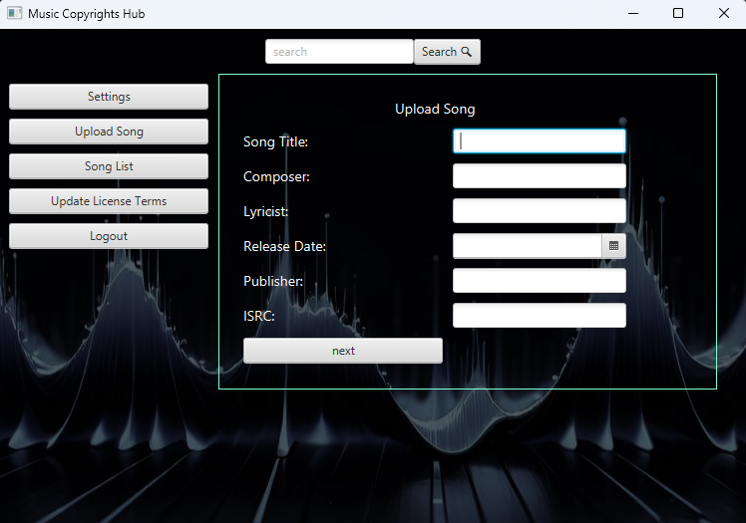
Artist Upload Song

Slide 8
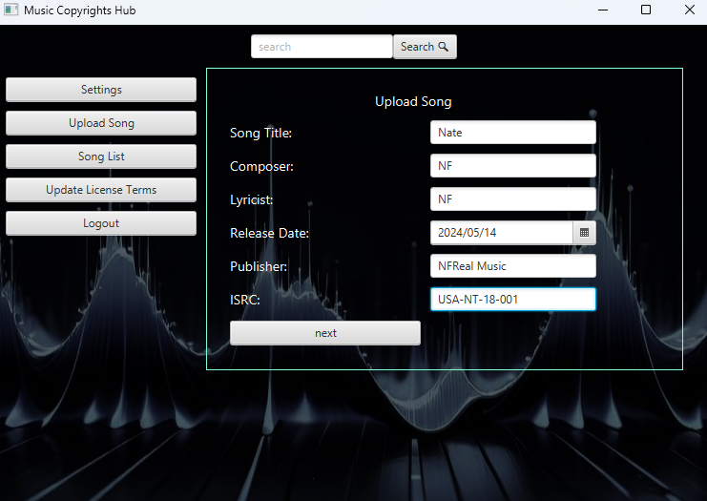
Artist Upload Song

Slide 9
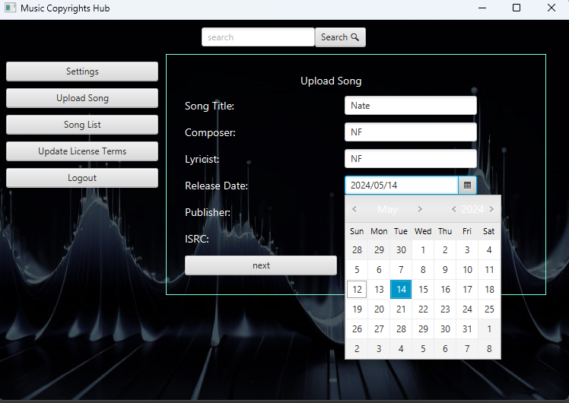
Artist Upload Song

Slide 10
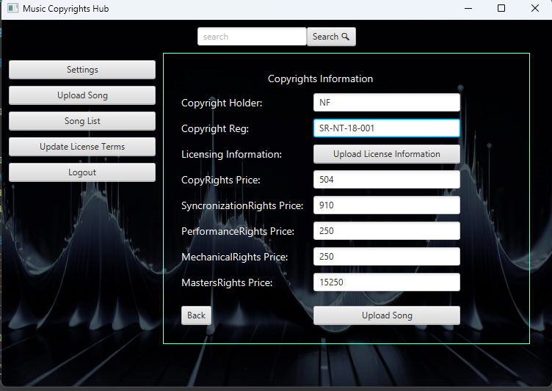
Artist Upload Copyrights Information

Slide 11
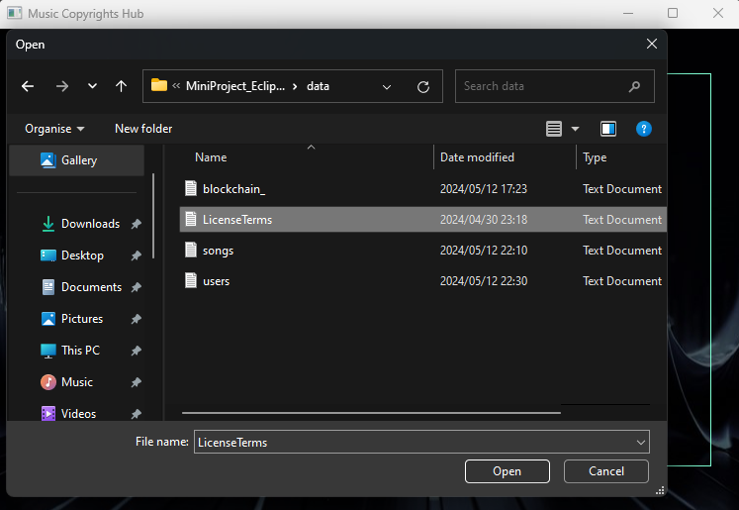
Artist Upload License Terms

Slide 12
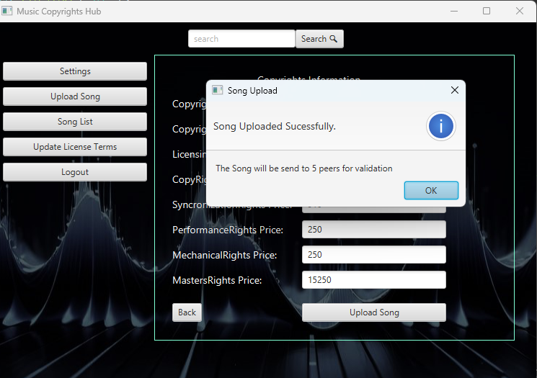
Artist Upload Song

Slide 13
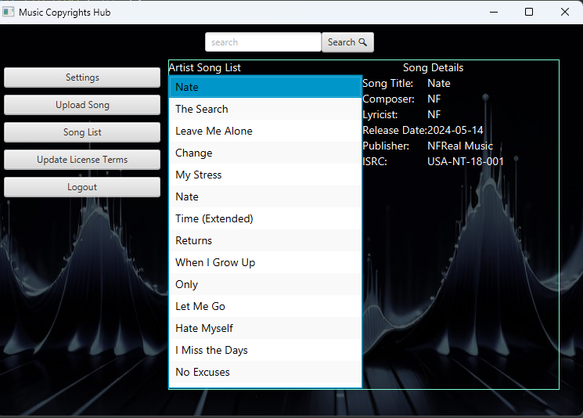
View Song Details

Slide 14
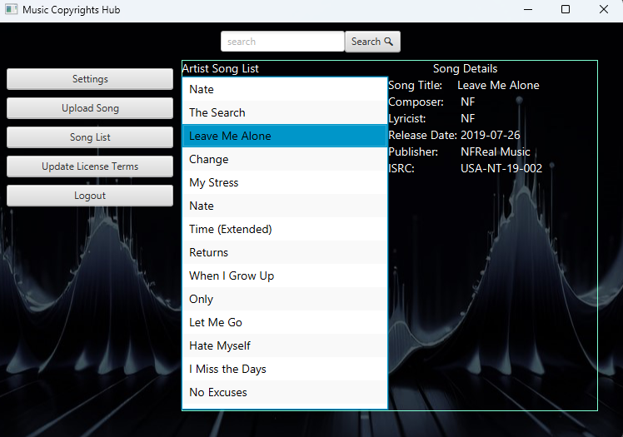
View Song details

Slide 15
Distributor
Name: Rob Kong
Email: rk@mail.com
Password:rk
Use Case: Buy Copyrights for Intaba Yase Dubai’s song Sabela

Slide 16
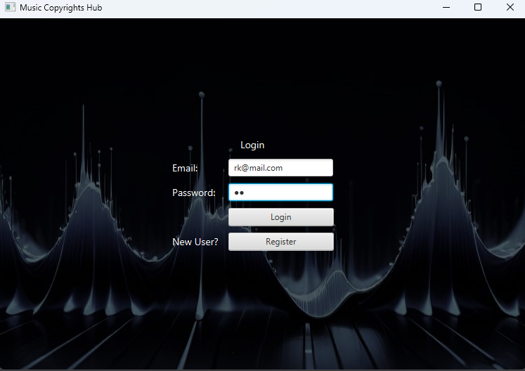
Distributor Login

Slide 17
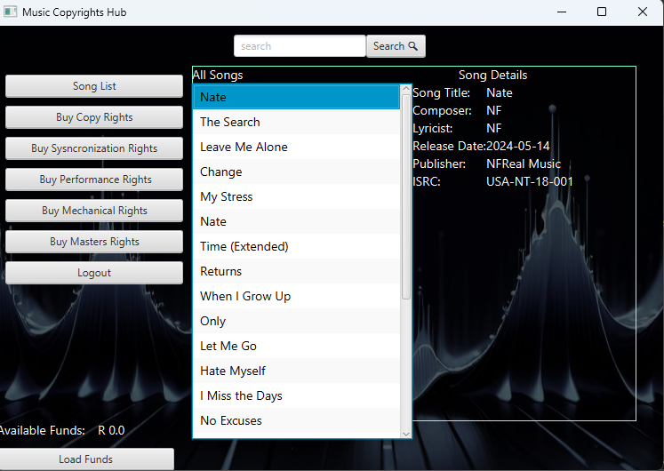
View Song details

Slide 18
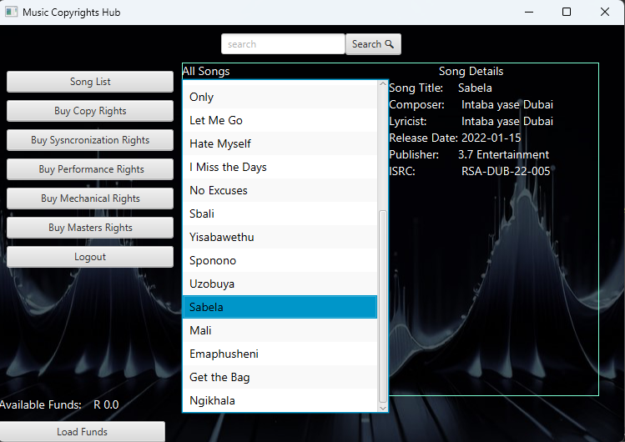
View Song details

Slide 19
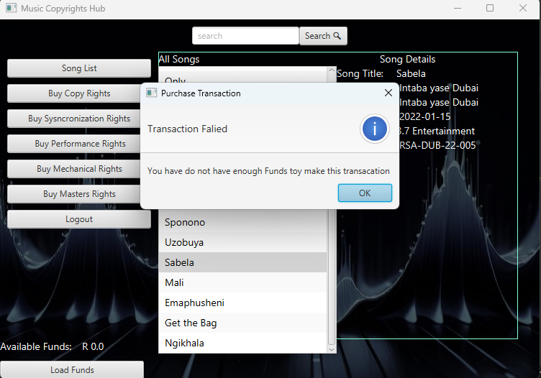
Transaction FaiLed

Slide 20
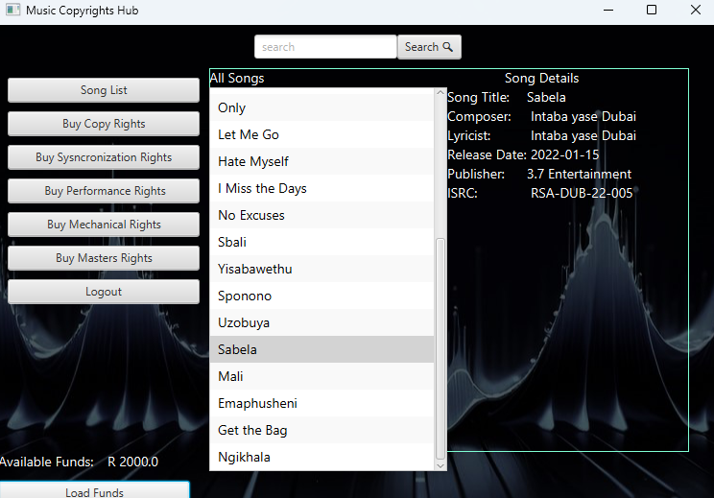
Update balance

Slide 21
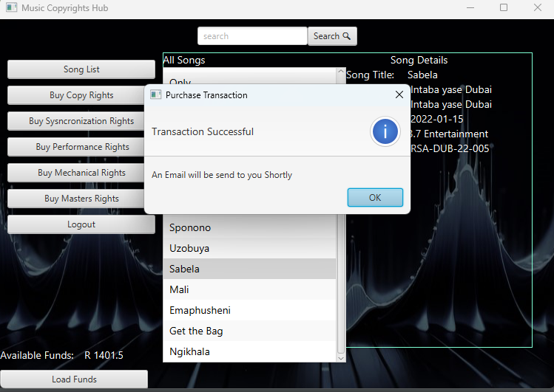
Transaction Successful

Slide 22
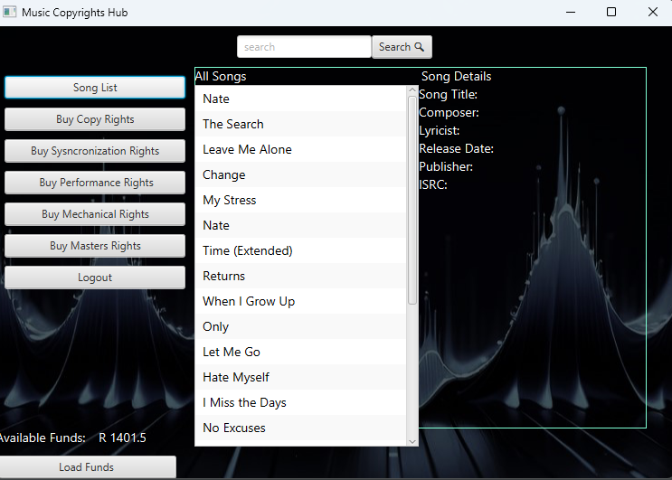
Updated account balance

Slide 23

User Authentication Page

Slide 24
Conclusion
The system empowers artists by giving them control over their music
The system also benefits distributors, record labels as well as Publishers
Timestamping and recording music rights information establishes a digital trail of ownership
Simplifies copyrights enforcement

